Slide 1



Project Name: Online Cake Shop
Institute for Advanced Computing and Software Development
Akrudi, Pune
Submitted By:
Group Number: 4
Archana Thapliyal
Kirti Jejurkar
Centre Coordinator:
Mr Prashant Karhale Project Guide:
Mr Chetan Pardesi

Slide 2
Contents
Introduction
Technology Used
Benefits of Online Cake Shop
Use Case Diagram
Project Flow
Drawbacks
Conclusion
Future Scope
References

Slide 3
Introduction
The Online Cake Shop web application provides complete solutions for customers through a single get way using the internet. It will enable customer to check for various cakes available at the shop and purchase cake online without having to visit the shop physically. The user interface will be simple and easy to understand even by the common man.

Slide 4
Technology Used
Spring Boot
Angular
MySQL

Slide 5
Benefits of Online Cake Shop
This Online Cake Shop is fully functional and flexible.
It is very easy to use.
This Online Cake Shop helps customer to order cake easily.
It saves a lot of time, money.
The application acts as an office that is open 24/7.
It provides custom features development and support with the application.

Slide 6
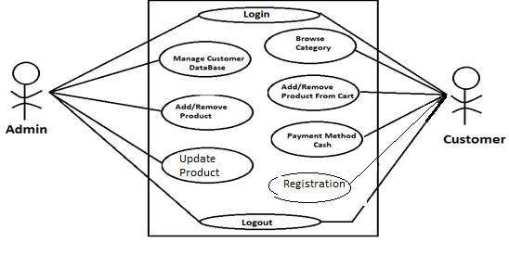
Use Case Diagram

Slide 7
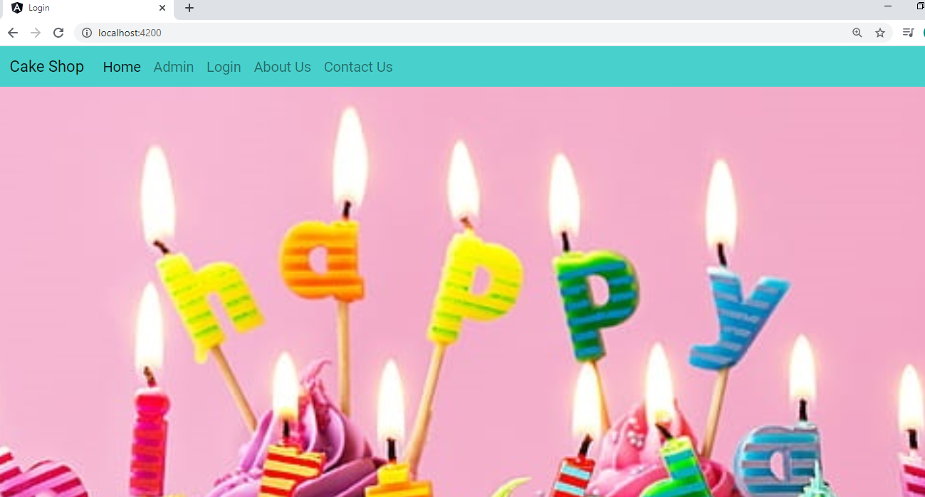
Home Page

Slide 8
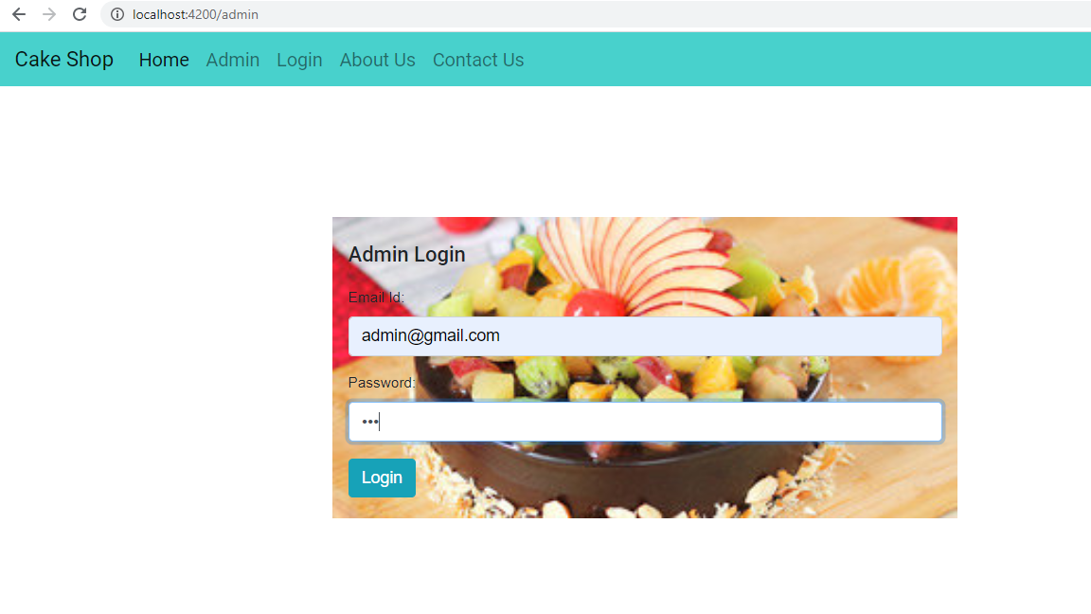
Admin Login

Slide 9
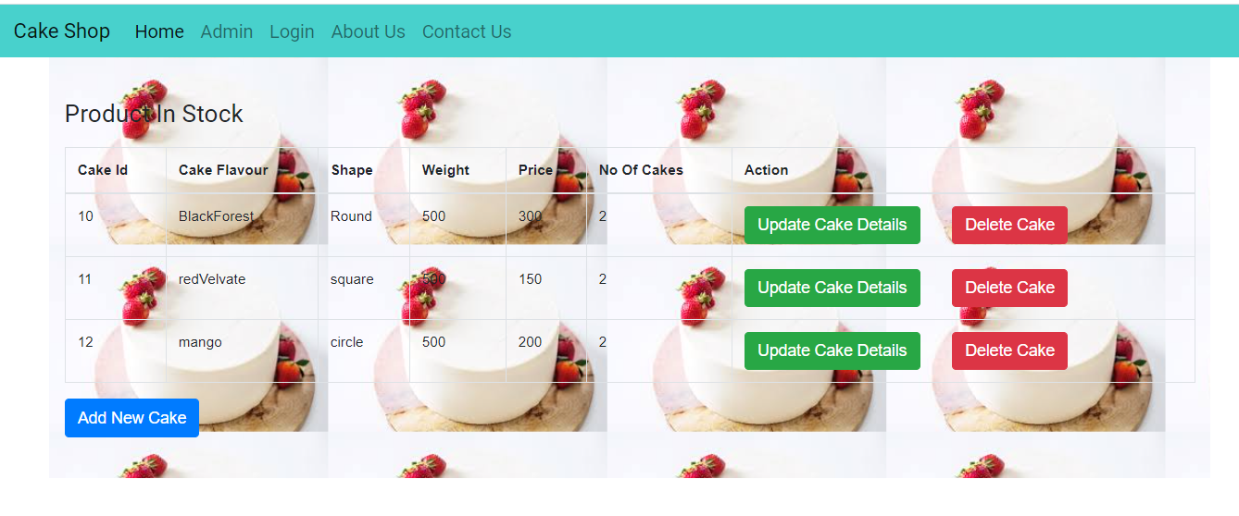
List Of Product

Slide 10
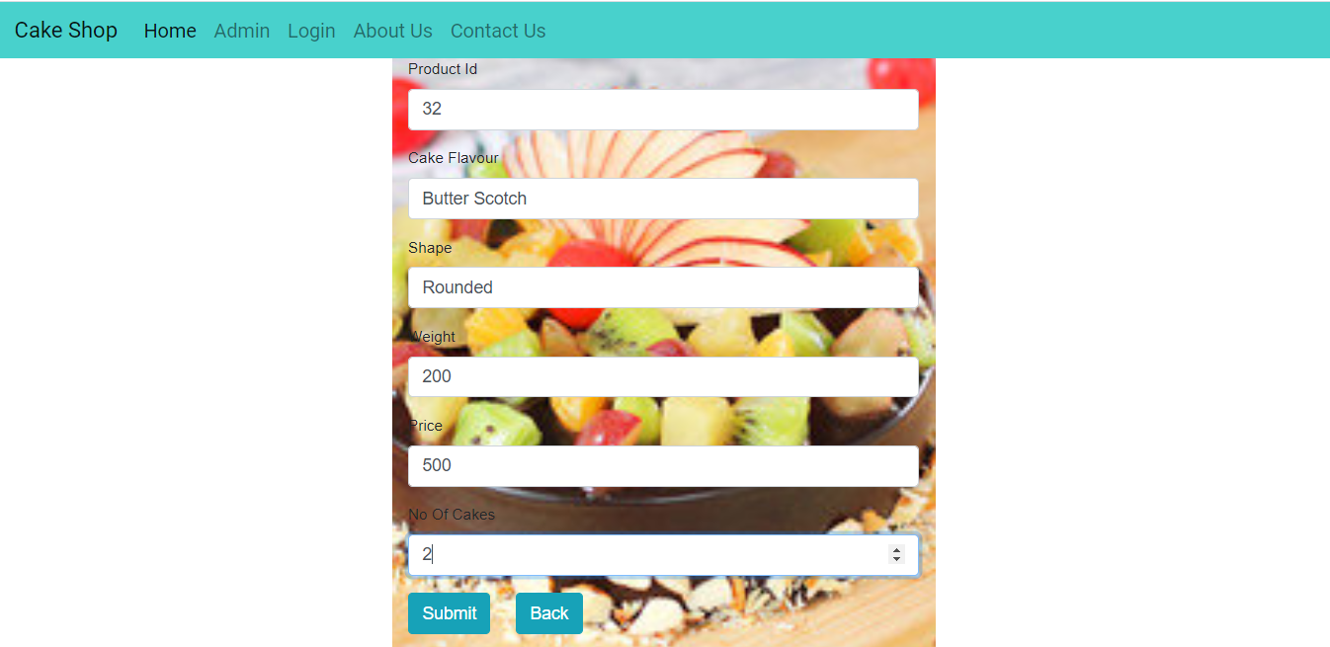
Add Product

Slide 11
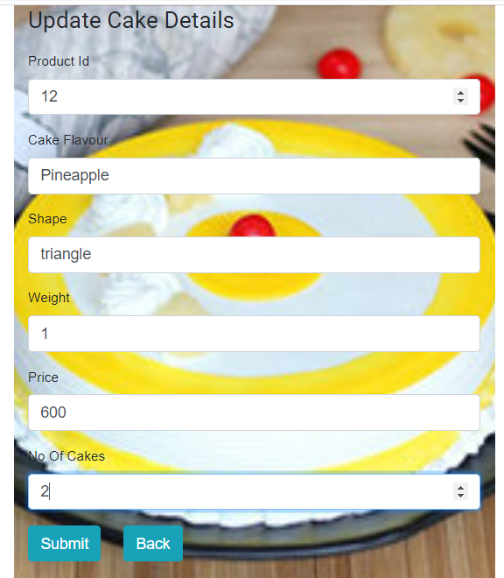
Update Product

Slide 12
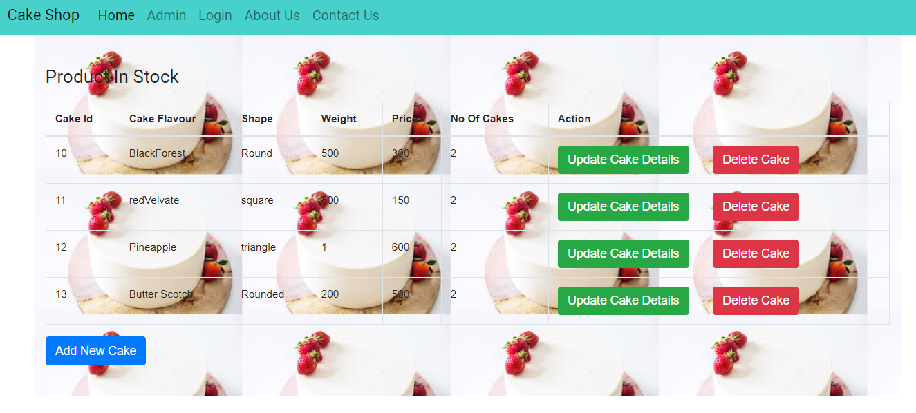
Updated Product

Slide 13
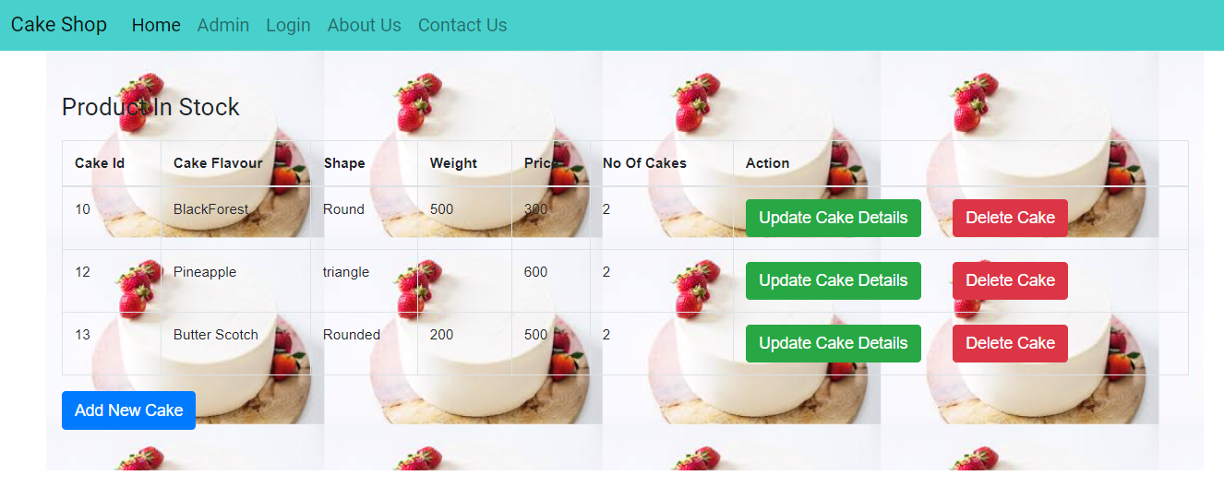
Delete Cake

Slide 14
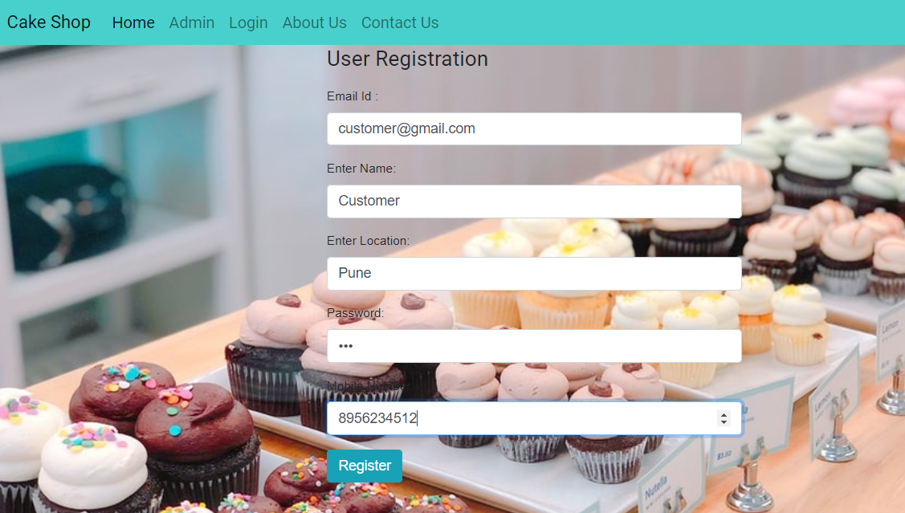
Customer Registration

Slide 15
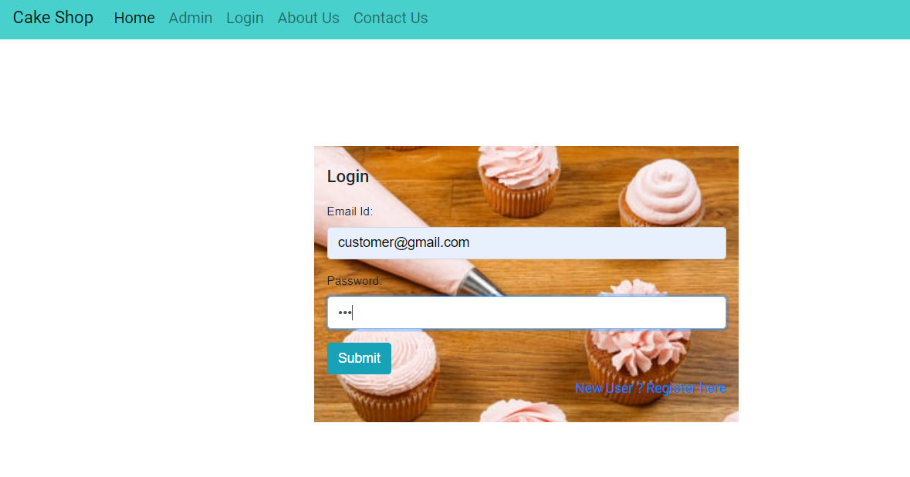
Customer Login

Slide 16
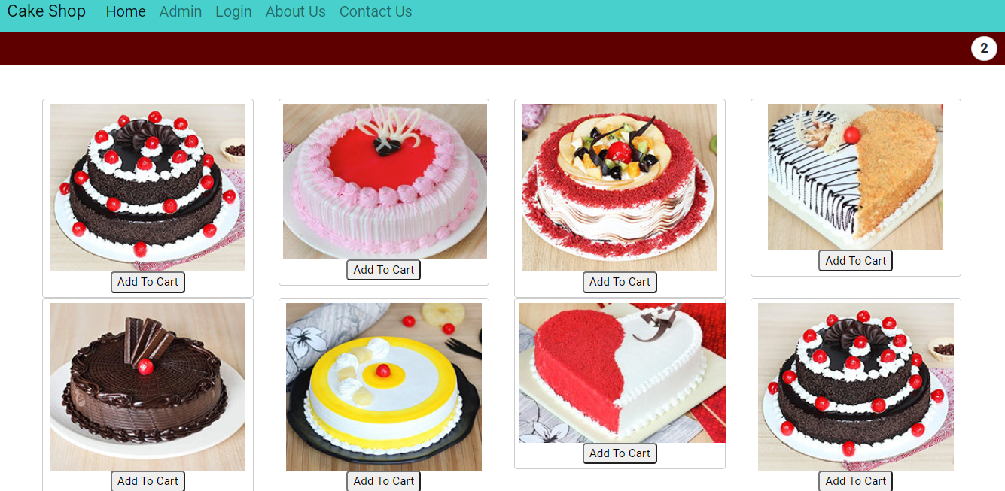
Product Categories

Slide 17
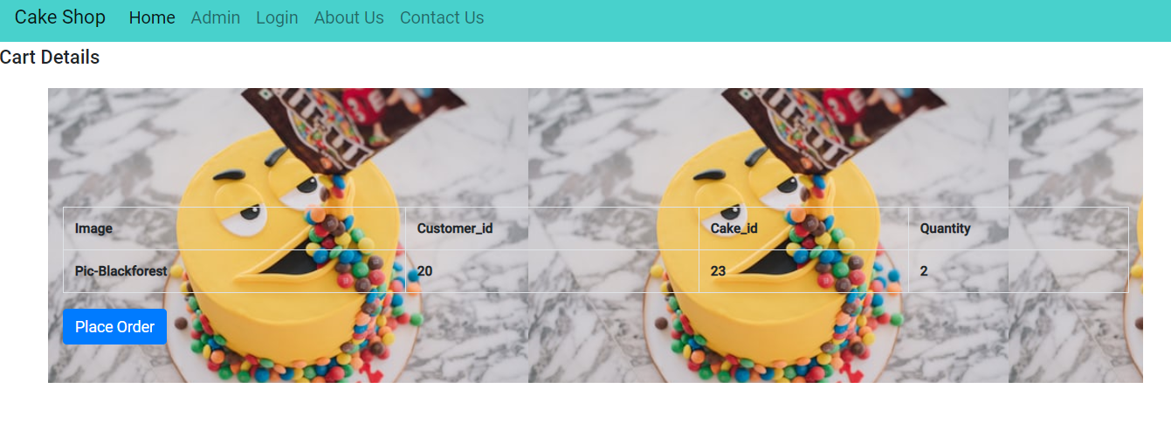
Cart Details

Slide 18
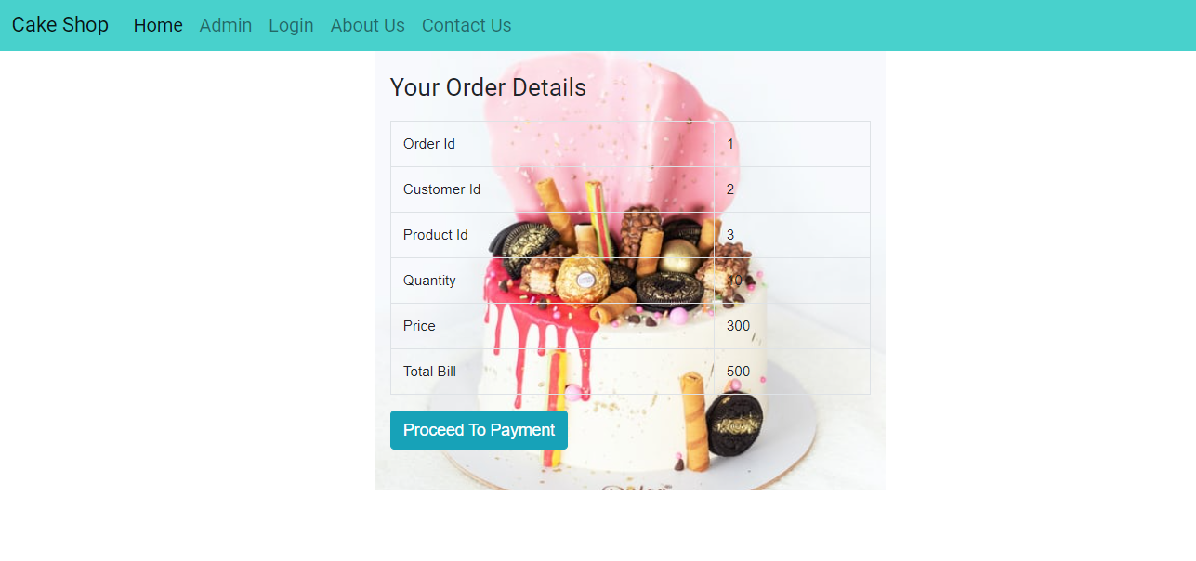
Order Details

Slide 19
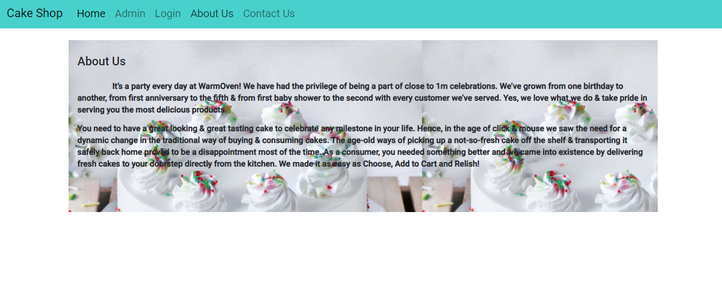
About Us

Slide 20
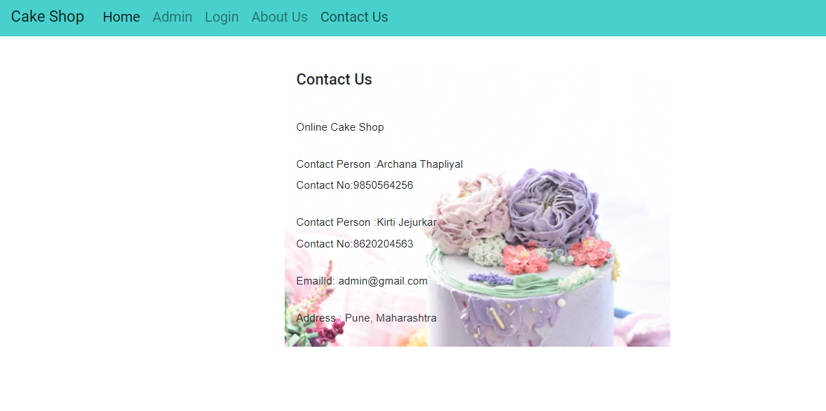
Contact Us

Slide 21
Drawbacks
This system is very time taking.
There will be many users visiting the website and hence we require a strong and reliable frontend which can with hold the users on our site.
We need a strong Database whereas data will be store for everyone.

Slide 22
Conclusion
These are the most of the points I can think right now. I will add more, if I think of more lately. I can customize the online cake ordering system for you as per customer need.

Slide 23
Future Scope
This project can be enhanced further by adding online payment facility for the order payment. The software is flexible enough to be modified and implemented as per future requirements. We have tried our best to present this free and user–friendly website to college students and faculty. Email alerts for various happenings in the college can be added to the system so that users do not miss the updates and happenings of the process.

Slide 24
References
https://www.researchgate.net/publication/323194738_Cakelicious_Web_App_for_Designing_a_Customised_Wedding_Cakes
(2017) DQ Cakes website [Online].
Available: http://www.dqcakes.com

Slide 25
Thank You

